Slide 1

Background Verification system
Project work - II Report
Department of Computer Science and Engineering
JAN-MAY (2022)
Submitted By Submitted To
Sumit Porwal(EN18CS301275) Mr. Prasanna Kapse
Mrs. Priyanka Dhasal

Slide 2
InternShip Details
Company Name : Consultadd Services Pvt. Ltd.
Internship Type : Off Campus
Role : Software Engineer Intern
Start Date : 04/01/2022
End Date : 30/06/2022
Duration : 6 Months

Slide 3
About the organisation
ConsultAdd Inc is a leading provider of Information Technology consulting and business process services. We offer strategic insights, technological expertise, and industry experience. ConsultAdd is one of the fastest growing IT consulting companies specializing in finance, banking, insurance, healthcare, retail, e-commerce domains and enterprise web development, data warehouse, business intelligence, big data in technologies.
With over 350 professionals working on information technology projects across united states, ConsultAdd is headquartered in TX and has the presence in Virginia, Pennsylvania, New York. ConsultAdd's offshore center is based in India at Pune.
Website - https://consultadd.com/
Company size - 400-500 employees
Headquarters - Texas, United States,Pune, India (Offshore Center)
Founded - 2011

Slide 4
Job Responsibilities
My profile will be Software Engineer Intern. I have been contributing in:
Rest API development with Spring Boot.
Developing Producer and Consumer API’s for producing and consuming messages from/to kafka topics.
Performing Unit-testing on the project.
Performed Inetgration testing using test containers.
Integrating with tools like Sonarqube and Jacoco for checking the code coverage.
Integrating Swagger for documenting the API’s.

Slide 5
Technologies Learned During Training
The technologies learned by me during the training period are:
Java
Spring Boot
Junit and Mockito
REST API’s
Microservices
Database - MongoDB, MySQL
Git & GitHub
Postman
Docker
ReactJS
Redux
Angular

Slide 6

Java
Java is a programming language and computing platform first released by Sun Microsystems in 1995. There are lots of applications and websites that will not work unless you have Java installed, and more are created every day. Java is fast, secure, and reliable.
Features of Java
Simple
Object-Oriented
Portable
Platform independent
Secured
Architecture neutral
Interpreted
High Performance
Multithreaded
Distributed

Slide 7

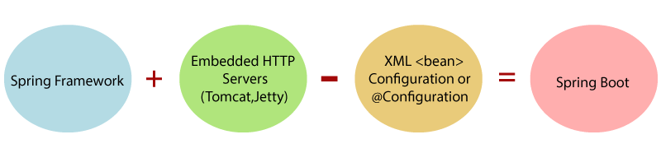
Spring Boot
Spring Boot is a project that is built on the top of the Spring Framework. It provides an easier and faster way to set up, configure, and run both simple and web-based applications.
It is a Spring module that provides the RAD (Rapid Application Development) feature to the Spring Framework. It is used to create a stand-alone Spring-based application that you can just run because it needs minimal Spring configuration.

Slide 8
Testing In Spring Boot
Software testing is the process of evaluating and verifying that a software product or application does what it is supposed to do. The benefits of testing include preventing bugs, reducing development costs and improving performance.
Tools used for testing in Spring Boot
Junit : JUnit is a unit testing framework for Java programming language. JUnit promotes the idea of "first testing then coding", which emphasizes on setting up the test data for a piece of code that can be tested first and then implemented.
Mockito: Mockito is a mocking framework, JAVA-based library that is used for effective unit testing of JAVA applications. Mockito is used to mock interfaces so that a dummy functionality can be added to a mock interface that can be used in unit testing.
SonarQube: SonarQube is an open-source and standalone service that provides an overview of the overall health of our source code by measuring code quality and code coverage.
Jacoco: Jacoco is an open source project, which can be used to check production code for test code coverage. It creates reports and integrates well with IDEs like the Eclipse IDE.

Slide 9

MySQL
MySQL is a relational database management system based on the Structured Query Language, which is the popular language for accessing and managing the records in the database. MySQL is open-source and free software under the GNU license. It is supported by Oracle Company.
MySQL is a Relational Database Management System (RDBMS) software that provides many things, which are as follows:
It defines the database relationship in the form of tables (collection of rows and columns), also known as relations.
It provides the Referential Integrity between rows or columns of various tables.
It allows us to updates the table indexes automatically.
It uses many SQL queries and combines useful information from multiple tables for the end-users.

Slide 10

ReactJS
ReactJS is a declarative, efficient, and flexible JavaScript library for building reusable UI components. It is an open-source, component-based front end library which is responsible only for the view layer of the application. It was initially developed and maintained by Facebook and later used in its products like WhatsApp & Instagram.
ReactJS Features
JSX
Components
One-way Data Binding
Virtual DOM
Simplicity
Performance

Slide 11

Angular
Angular is a JavaScript framework written in TypeScript and maintained by Google. It enables users to develop and test large applications easily. It has surpassed Javascript for developing single-page applications that require modularity, testability, and developer productivity.
Features of Angular
Declarative UI
Typescript
Easy Testing

Slide 12

Apache Kafka
Apache Kafka is a distributed data store optimized for ingesting and processing streaming data in real-time. Streaming data is data that is continuously generated by thousands of data sources, which typically send the data records in simultaneously. A streaming platform needs to handle this constant influx of data, and process the data sequentially and incrementally.
Kafka provides three main functions to its users:
Publish and subscribe to streams of records
Effectively store streams of records in the order in which records were generated
Process streams of records in real time

Slide 13

git
Git is a mature, actively maintained open-source project originally developed in 2005 by Linus Torvalds, the famous creator of the Linux operating system kernel. A staggering number of software projects rely on Git for version control, including commercial projects as well as open-source.
Features of Git
Tracks history
Free and open source
Supports non-linear development
Creates backups
Scalable
Supports collaboration
Branching is easier

Slide 14

Docker
Docker is a platform for packaging, deploying, and running applications. Docker applications run in containers that can be used on any system: a developer’s laptop, systems on premises, or in the cloud.
Containerization has enjoyed widespread adoption because of its
Consistent test environment for development and QA.
Cross-platform packages called images.
Isolation and encapsulation of application dependencies.
Ability to scale efficiently, easily, and in real time.
Enhances efficiency via easy reuse of images.

Slide 15

Gradle
Gradle is an open source build automation tool that is based on the concept of Apache Maven and Apache Ant. It is capable of building almost any type of software. It is designed for the multi-project build, which can be quite large.
It introduces a Java and Groovy-based DSL(Domain Specific Language) instead of XML (Extensible Markup Language) for declaring the project configuration. It uses a DAG (Directed Acyclic Graph) to define the order of executing the task.

Slide 16
Project
Background Verification System
The Project “Background Verification System” is a web application based on the Background Verification of the documents of the newly hired employees. The old application already exists which is monolithic application. It has been migrated to a MicroService based application. It is based on event driven architecture.
It was mainly built using Spring Boot. It was tested using Junit and Mockito. It is using gradle as the build tool. It is using gitlab for git versioning and also uses argoCD for continuos deployment.

Slide 17
Tools and Technologies Used
The technology stack used in the project are as follows
Backend: Spring Boot
Frontend: ReactJS
Database: MySQL
Testing: Junit, Mockito
IDE: Intellij
Build Tool: Maven
Git Repository: Github
Tools Used: SonarQube, Jacoco, Postman

Slide 18
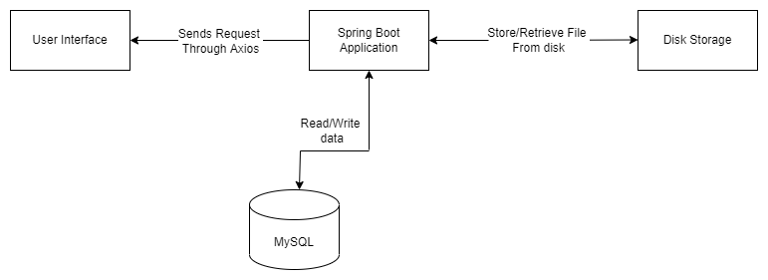
Background Verification System Architecture

Slide 19
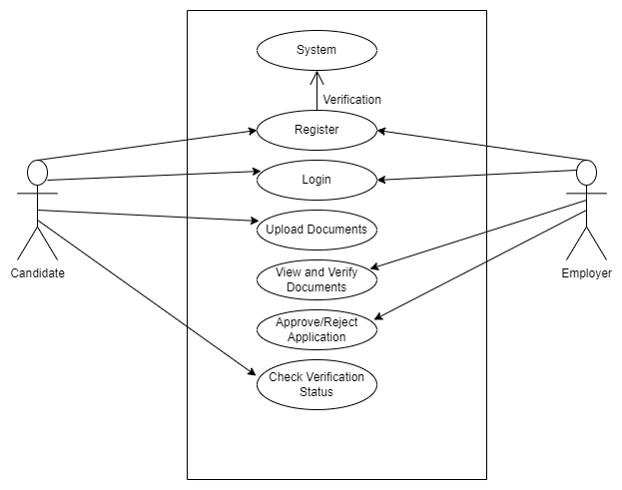
USE CASE DIAGRAM

Slide 20
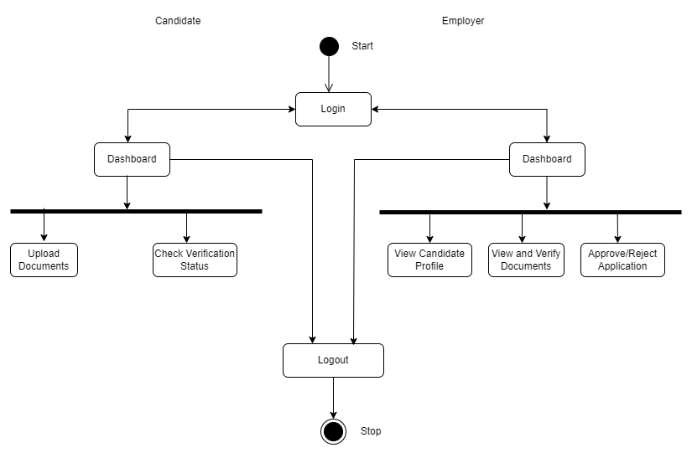
ACTIVITY DIAGRAM

Slide 21
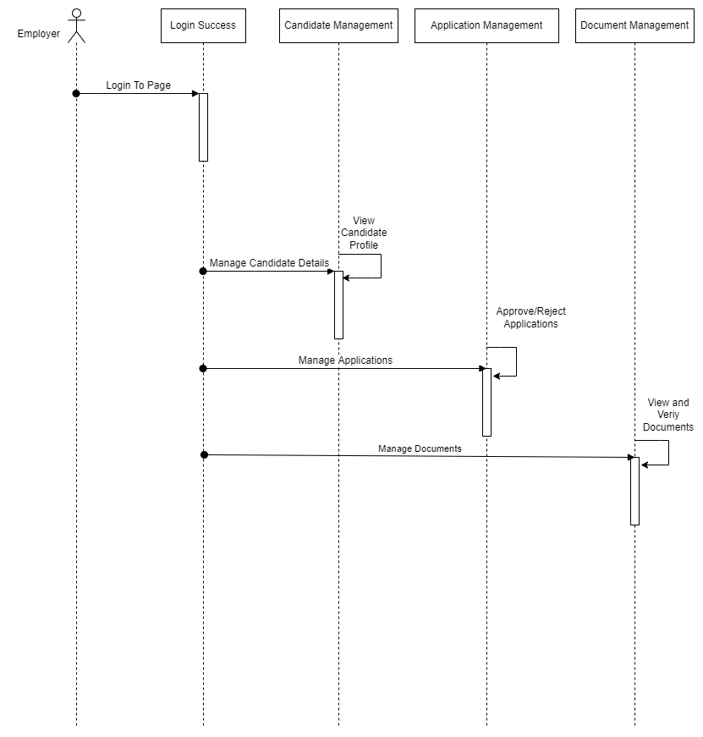
EMPLOYER SEQUENCE DIAGRAM

Slide 22
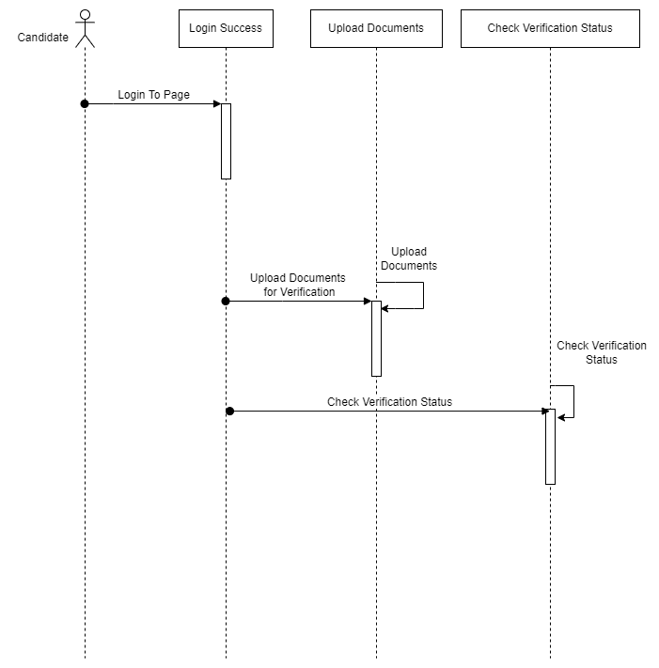
CANDIDATE SEQUENCE DIAGRAM

Slide 23
Project Testing
Software testing is the process of evaluating and verifying that a software product or application does what it is supposed to do. The benefits of testing include preventing bugs, reducing development costs and improving performance.
Unit Testing
This type of testing is performed by developers before the setup is handed over to the testing team to formally execute the test cases. Unit testing is performed by the respective developers on the individual units of source code assigned areas. The developers use test data that is different from the test data of the quality assurance team.The goal of unit testing is to isolate each part of the program and show that individual parts are correct in terms of requirements and functionality.

Slide 24
Integration Testing
After each unit is thoroughly tested, it is integrated with other units to create modules or components that are designed to perform specific tasks or activities. These are then tested as group through integration testing to ensure whole segments of an application behave as expected (i.e, the interactions between units are seamless). These tests are often framed by user scenarios, such as logging into an application or opening files. Integrated tests can be conducted by either developers or independent testers and are usually comprised of a combination of automated functional and manual tests.

Slide 25
TEST CASES
Login
Employer Login
Test Case ID | Test | Expected Input | Expected Output | Actual Result | Status
1. | To Login into the Employer Dashboard | Username, Password | Login Successfully | Logged in Successfully (Employer Dashboard) | Pass
2. | Trying to Login with wrong Email/Password | Username, Password | Not able to Login | Not able to Login | Pass

Slide 26
Candidate Login
Test Case ID | Test | Expected Input | Expected Output | Actual Result | Status
1. | To Login into the Candidate Dashboard | Username, Password | Login Successfully | Logged in Successfully (Candidate Dashboard) | Pass
2. | Trying to Login with wrong Email/Password | Username, Password | Not able to Login | Not able to Login | Pass

Slide 27
Register New Employer, Candidate
Test Case ID | Test | Expected Input | Expected Output | Actual Result | Status
1. | To Register new Employer and Candidate | Name, Email, , Department, Username and Password | Registered Successfully | Registered Successfully | Pass
2. | Trying to Register with any field being empty or already registered email | Name, Email, Department, Username and Password | Not able to Register | Not able to Register | Pass

Slide 28
Upload Document
Test Case ID | Test | Expected Input | Expected Output | Actual Result | Status
1. | To Upload Documents for Verification | File to upload | Uploaded Successfully | Uploaded Successfully | Pass
2. | Trying to Submit the form with any field being empty | File to upload | Not able to upload the file | Not able to upload the file | Pass

Slide 29
Approve/Reject Application
Test Case ID | Test | Expected Input | Expected Output | Actual Result | Status
1. | To Approve/ Reject Application | Click the Approve/Reject Button | Approved/ Rejected Successfully | Approved/ Rejected Successfully | Pass
2. | Trying to Approve/ Reject without clicking on the button | Click the Approve/Reject Button | Not able to Approve/ Reject Application | Not able to Approve/ Reject Application | Pass

Slide 30
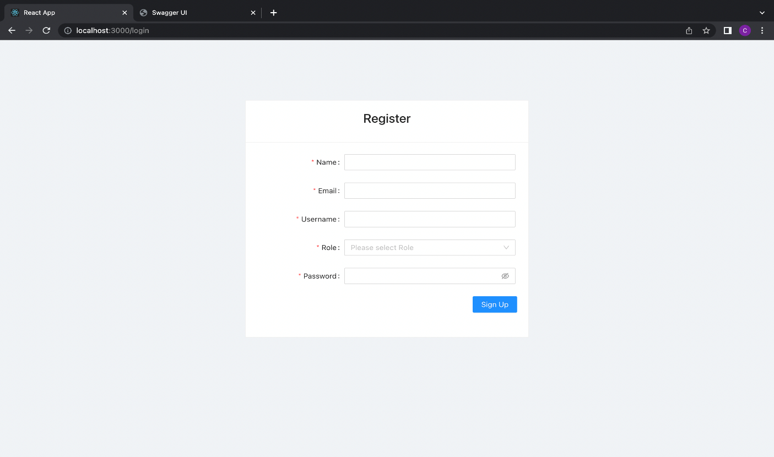
SNAPSHOTS OF PROJECT
1. Register View

Slide 31
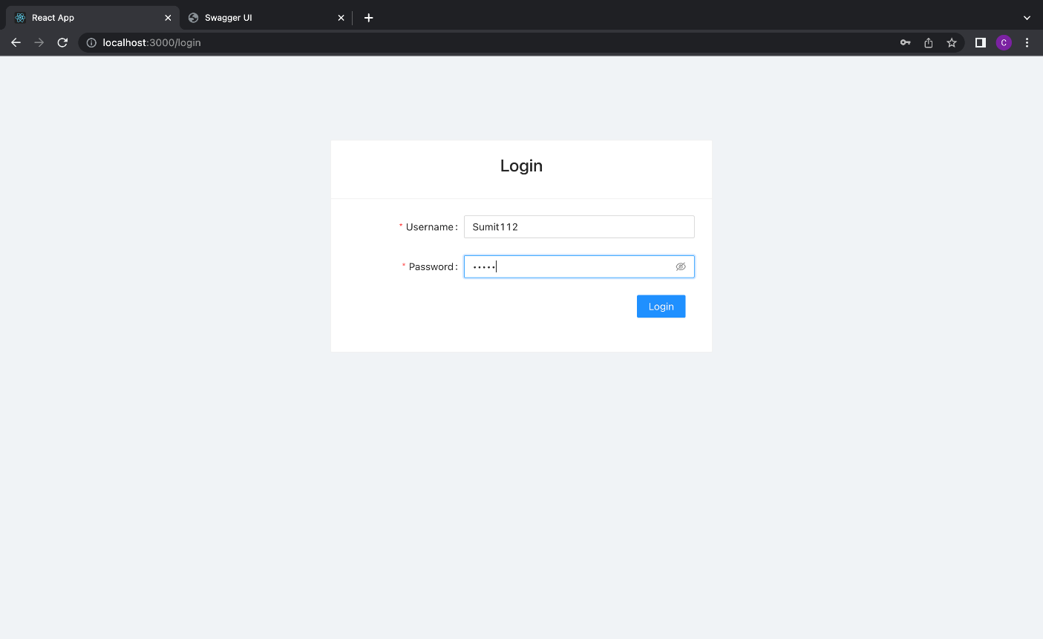
2. Login View

Slide 32
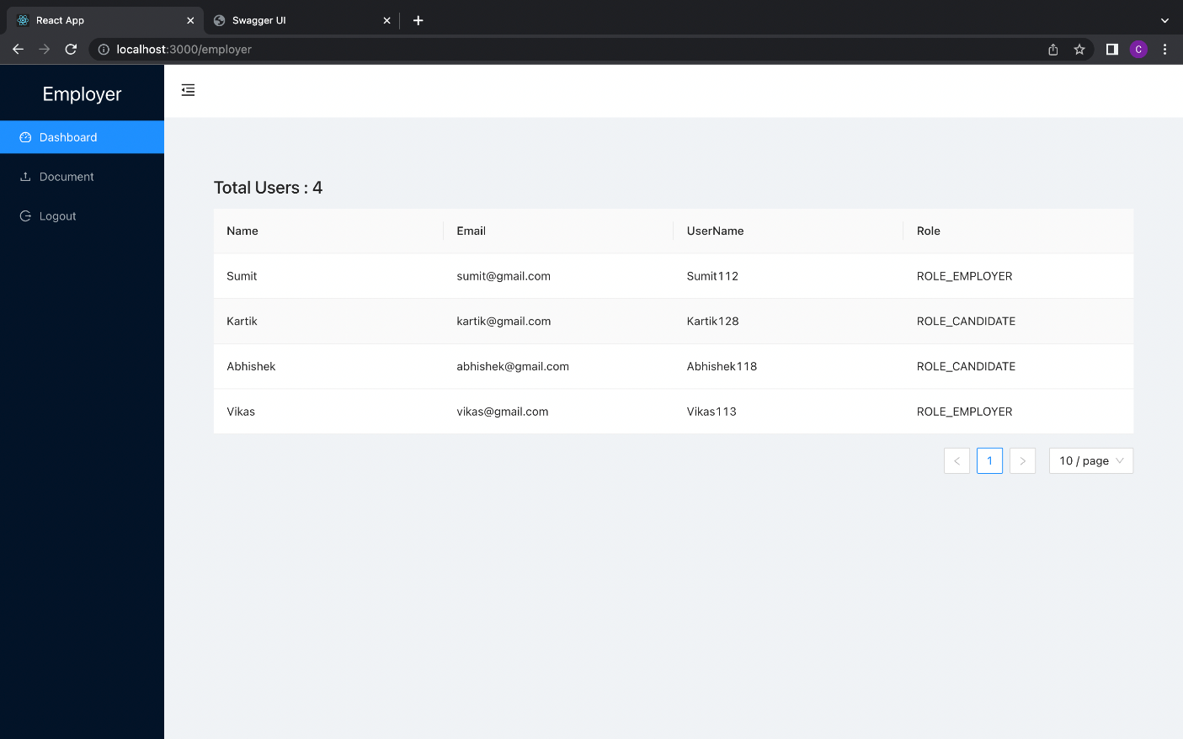
3. Employer Dashboard

Slide 33
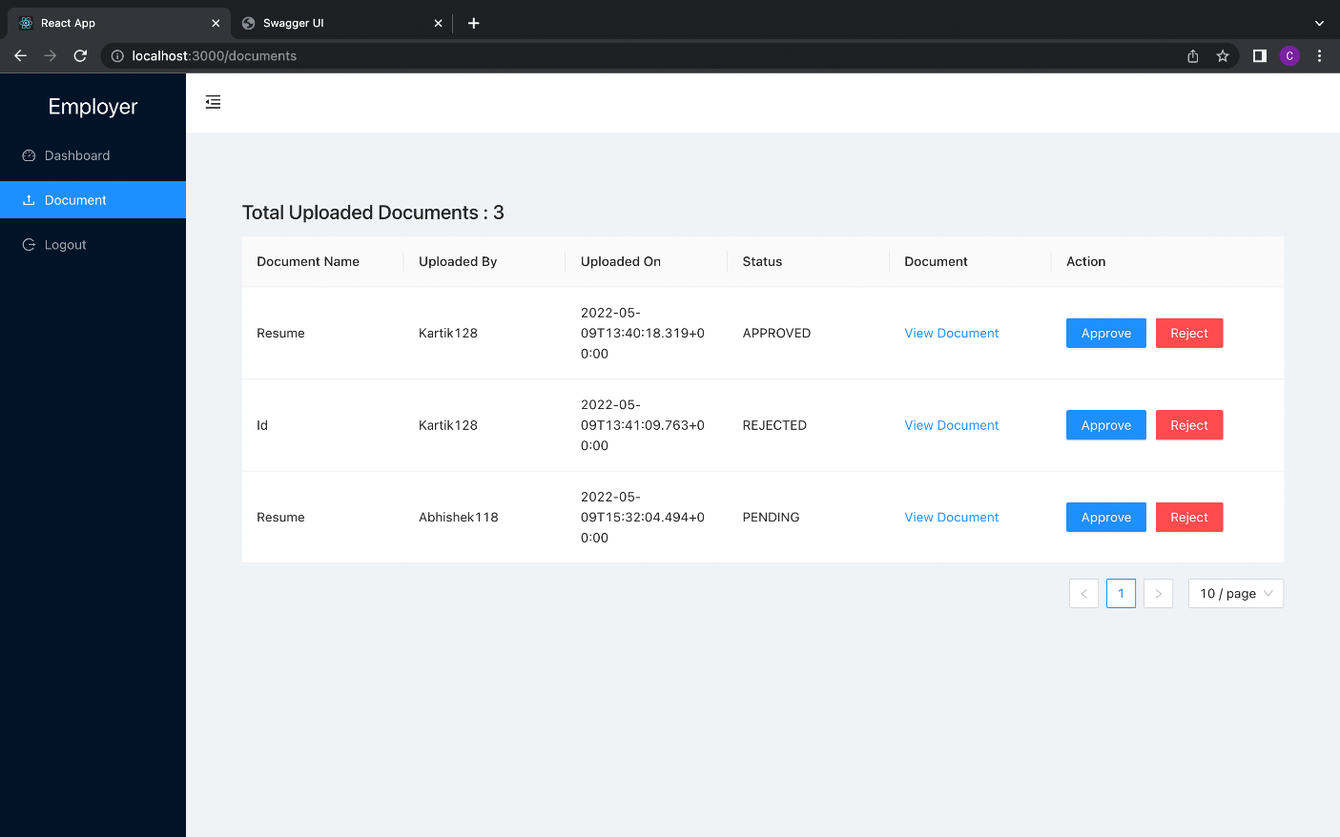
4. Employer Documents View

Slide 34
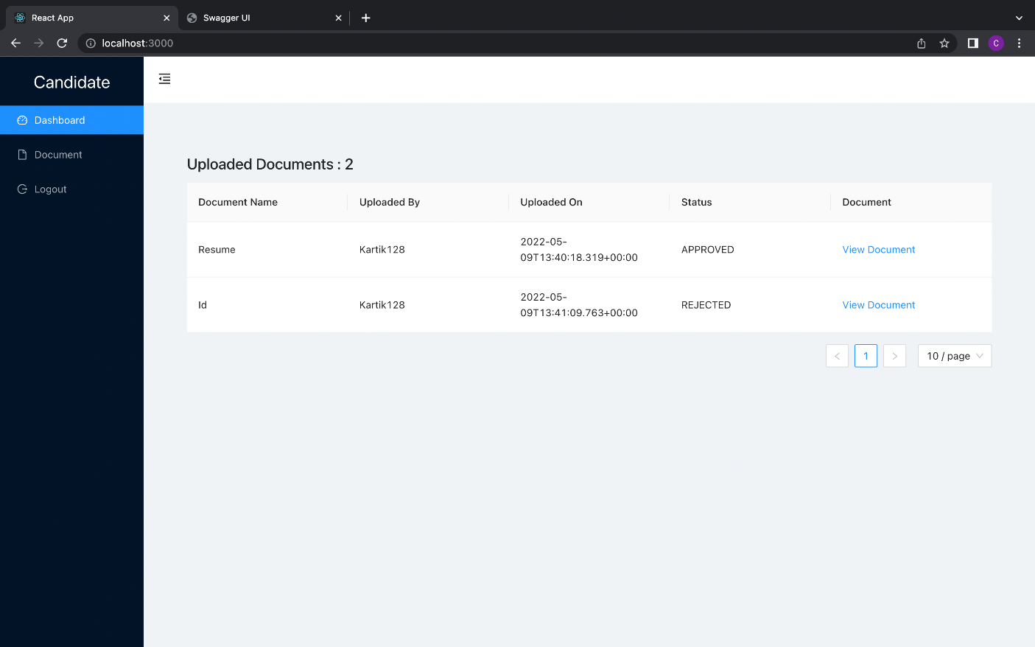
5. Candidate Dashboard

Slide 35
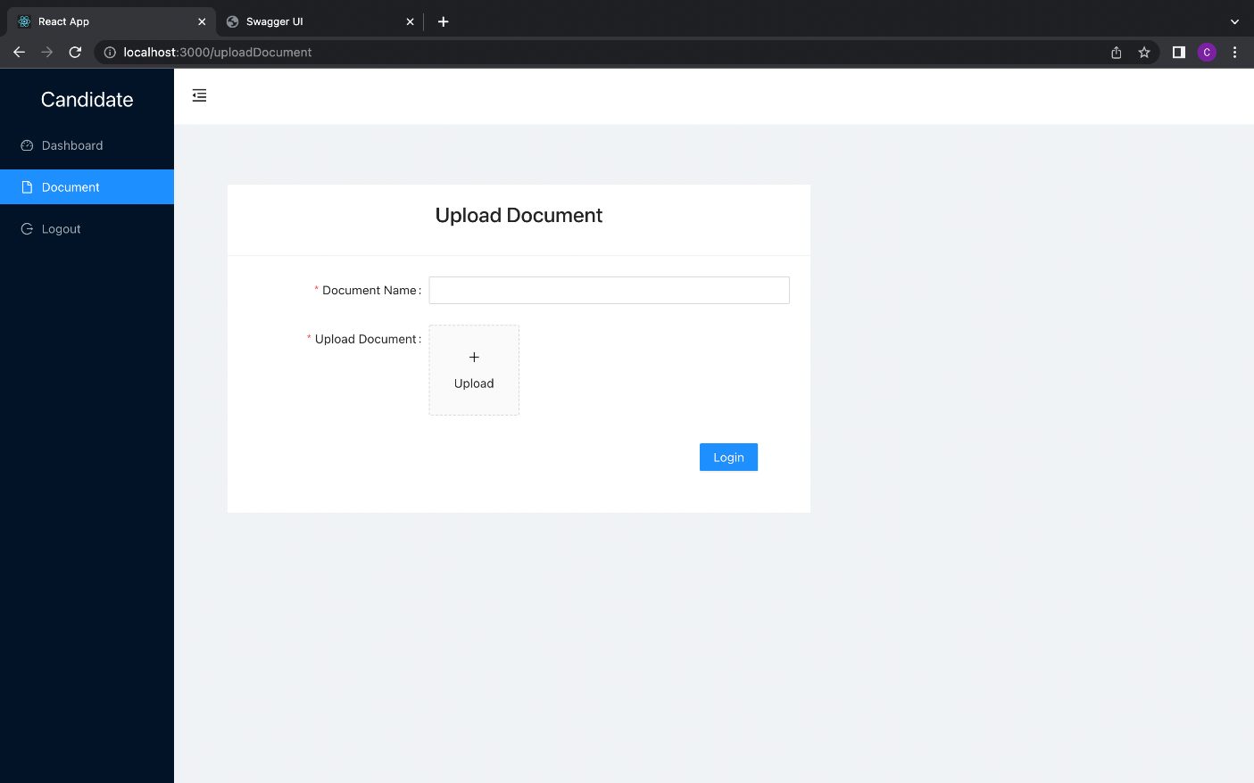
6. Candidate Upload Document Page

Slide 36
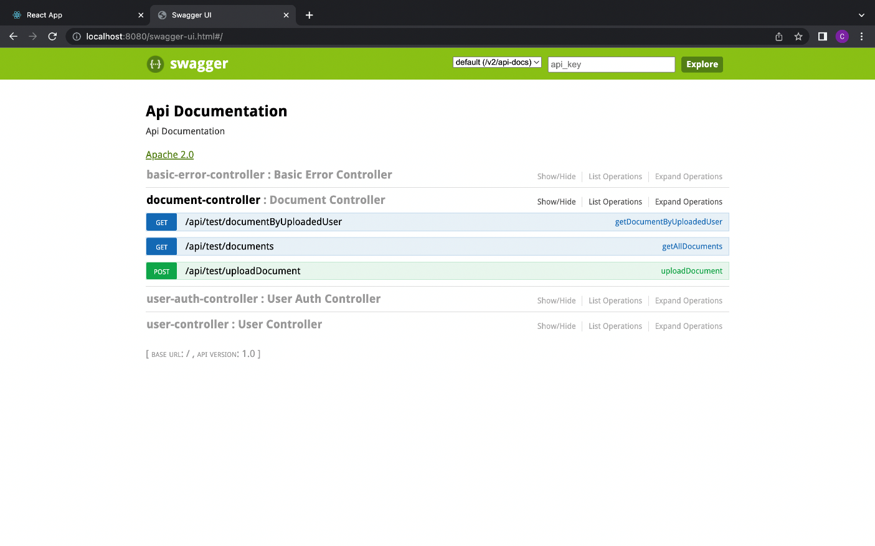
7. Swagger UI Page(API Documentation)

Slide 37
Thank you

